Slide 1
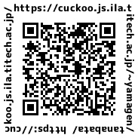
The Nihongo Space Presents
Tanabata
Week!
Make a wish upon a star
How can I make a wish? Take a look at QR code site!
Web page

